Slide 1

Computer System Architecture
Course Code IT2101
Subject Guide: Dr. Aprna Tripathi

Slide 2
Course Objectives:
The core objective of this course is to describe the general organization and architecture of a computer system.
It covers in detail the description and design of basic computer, functional units, machine instructions, control unit and memory hierarchy design.
It provides a detailed coverage of logic circuits to perform various arithmetic operations and use of pipelining to achieve parallelism to achieve at different levels using hardware and software techniques to yield high-performance processors.

Slide 3
Course Outcomes:
A student who successfully fulfills the course requirements will be able to:
[2101.1]. Understand the concepts of different combinational and sequential circuits.
[2101.2]. Explain various microoperations and different components of computer organization.
[2101.3]. Describe the operations of control unit and design of various arithmetic circuits.
[2101.4]. Analysis the concepts of I/O organization and memory organization.
[2101.5]. Illustrate the working of pipelining, its interconnection structure and architecture of different processors.

Slide 4
Student Outcomes (SO):
An ability to apply the knowledge of mathematics, science and computing appropriate to the discipline
An ability to analyze a problem, identify and define the computing requirements appropriate to its solution.
An ability to design, implement and evaluate a system / computer‐based system, process, component or program to meet desired needs

Slide 5
Assessment Pattern:
At least four assignment
Three quizzes out of which best two will be considered
Quiz can be conducted before announcement
In final assessment
Assignment- 10
Quiz – 10

Slide 6
Syllabus
Basics of Digital Electronics: Codes, Logic Gates, Flip-Flops, Registers, Counters, Multiplexer, De-multiplexer, Encoder, Decoder;
RTL and Micro Operations: Register Transfer, Bus and Memory Transfer, Logic Micro Operations, Shift Micro Operations;
Basic Computer Organization: Complete Computer Description & Design of Basic Computer, Instruction Codes, Computer Instructions, Timing & Control, Instruction Cycles, Memory Reference Instructions, Input/output & Interrupts;
Control Unit: Hardwired vs. Micro Programmed Control Unit, Central Processing Unit, General Register Organization, Stack Organization, Instruction Format, Data Transfer & Manipulation, Program Control, RISC, CISC;
Computer Arithmetic: Addition & Subtraction, Multiplication Algorithms, Division Algorithms;
Input-Output Organization: Peripheral devices, I/O interface, Data Transfer Schemes, Program Control, Interrupt, DMA Transfer, I/O Processor;
Memory Unit: Memory Hierarchy, Processor vs. Memory Speed, High-speed Memory, Cache Memory, Associative Memory, Interleave, Virtual Memory, Memory Management;
Introduction to Parallel Processing: Pipelining, Characteristics of Multiprocessors, Interconnection Structures, Inter-processor Arbitration, Inter-processor Communication & Synchronization;
Case Studies: Case Studies of some Contemporary Advanced Architecture for Processors of Families like Intel, AMD, IBM.

Slide 7
Text Books:
The main textbook is:
T1. M. Morris Mano, “Computer System Architecture”, Pearson, 3rd Edition Revised, 2017.

Slide 8
Reference Books:
R1. W. Stallings, “Computer Organization and Architecture –Designing for Performance”, PHI, 2009.
R2. S. Salivahanan & S. Arivazhagan, Digital Circuits and Design, Oxford University Press; Fifth edition, 2018.
R3. David A. Patterson, John L. Hennessy, “Computer Organization and Design: The Hardware/Software Interface”, Morgan Kauffmann, 4th Edition, 2010.
R4. John P. Hayes, “Computer Architecture and Organization”, TMH, 3rd Edition, 1999

Slide 9
Lecture 2.3
Multiplexer and demultiplexer

Slide 10
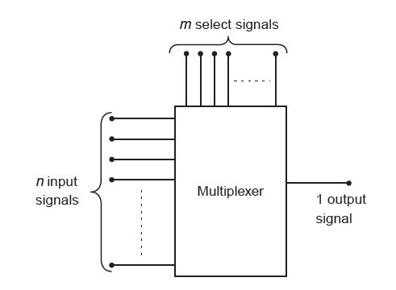
MULTIPLEXERS
Multiplexer is also called as many to one circuit.
Multiplexing is the process of transmitting a large number of information over a single line.
Digital Multiplexer is a combinational circuit that selects one digital information from several sources and transmit the selected information on a single output line
$$n=2^{m}$$

Slide 11
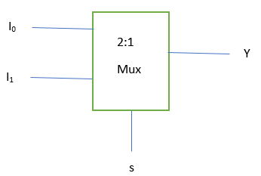

2:1 multiplexer
Select Line S | Output Line Y
0 | I₀
1 | I₁
$$Y=\overline{S}I_{0}+SI_{1}$$

Slide 12
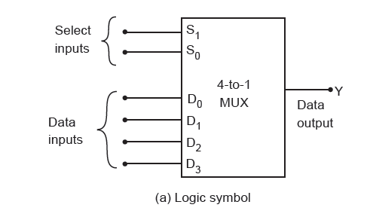
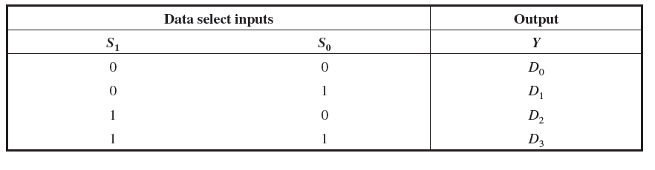
4 to 1 MULTIPLEXER
It has four data input lines (D0 – D3), a single output line ( Y ) and two select lines (S0 and S1) to select one of the four input lines

Slide 13
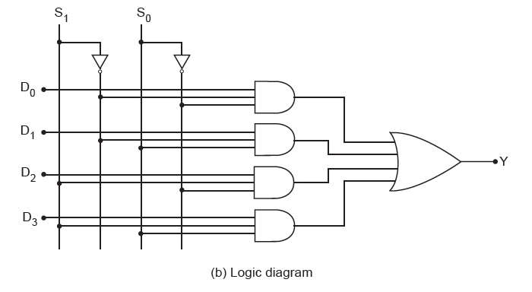

4 to 1 MULTIPLEXER

Slide 14
8:1 Multiplexer
S₂ | S₁ | S₀ | Y
0 | 0 | 0 | I₀
0 | 0 | 1 | I₁
0 | 1 | 0 | I₂
0 | 1 | 1 | I₃
1 | 0 | 0 | I₄
1 | 0 | 1 | I₅
1 | 1 | 0 | I₆
1 | 1 | 1 | I₇

Slide 15
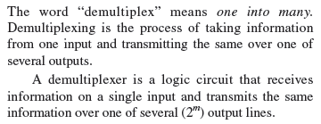
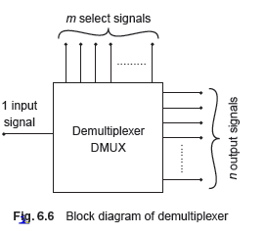
DE - MULTIPLEXERS

Slide 16
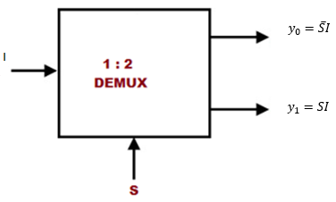
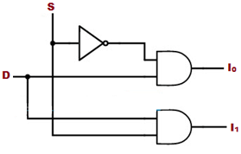
1-2 DeMultiplexer
S | Y₀ | Y₁
0 | I | 0
1 | 0 | I

Slide 17
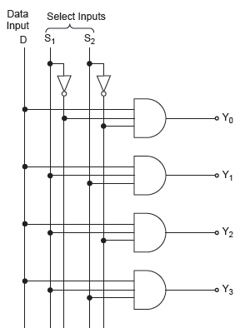
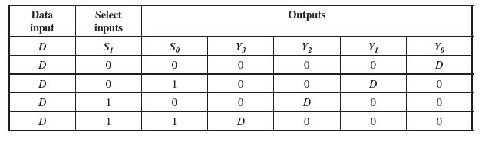
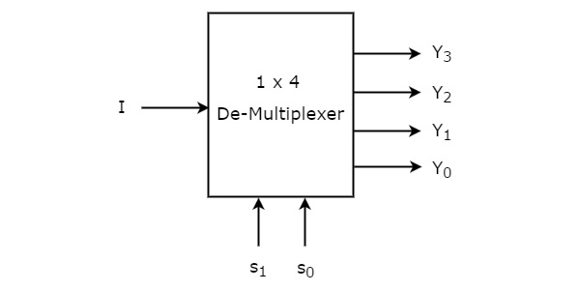
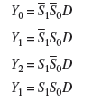
1 to 4 De – Multiplexer

Slide 18
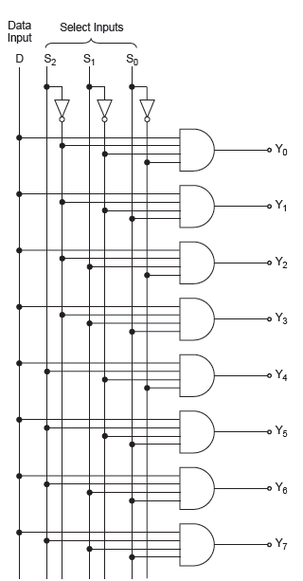
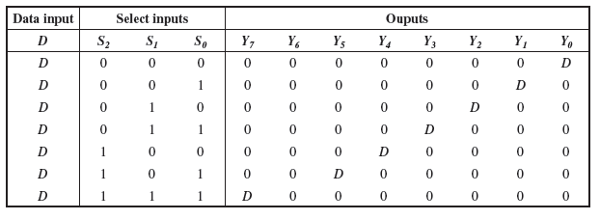
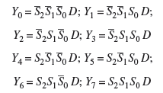
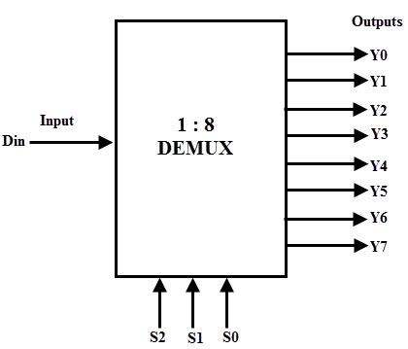
1 to 8 De – Multiplexer

Slide 19
Lecture 2.4
Decoder -Encoder

Slide 20
DECODER
Decoder is a combinational circuit that convert binary information from n input lines to a maximum of 2^{n} unique output lines n to m line decoder
Where m<=2^{n}

Slide 21
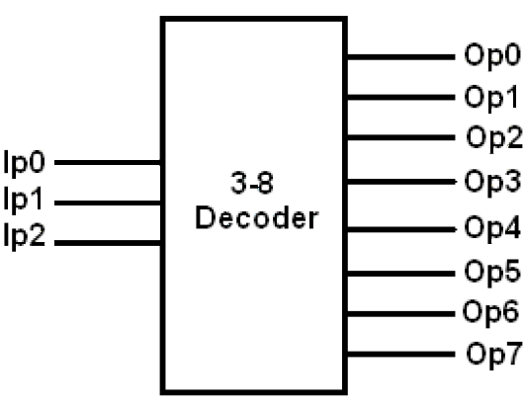
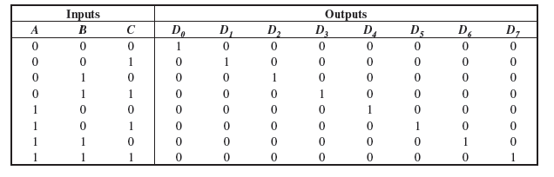
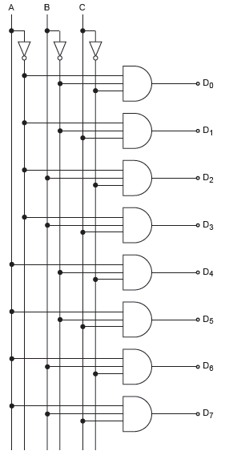

3 to 8 Decoder

Slide 22
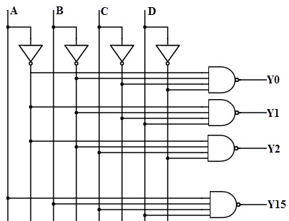
4 to 16 Decoder
A | B | C | D | Y0 | Y1 | Y2 | Y3 | Y4 | Y5 | Y6 | Y7 | Y8 | Y9 | Y10 | Y11 | Y12 | Y13 | Y14 | Y15
0 | 0 | 0 | 0 | 1 | 0 | 0 | 0 | 0 | 0 | 0 | 0 | 0 | 0 | 0 | 0 | 0 | 0 | 0 | 0
0 | 0 | 0 | 1 | 0 | 1 | 0 | 0 | 0 | 0 | 0 | 0 | 0 | 0 | 0 | 0 | 0 | 0 | 0 | 0
0 | 0 | 1 | 0 | 0 | 0 | 1 | 0 | 0 | 0 | 0 | 0 | 0 | 0 | 0 | 0 | 0 | 0 | 0 | 0
0 | 0 | 1 | 1 | 0 | 0 | 0 | 1 | 0 | 0 | 0 | 0 | 0 | 0 | 0 | 0 | 0 | 0 | 0 | 0
0 | 1 | 0 | 0 | 0 | 0 | 0 | 0 | 1 | 0 | 0 | 0 | 0 | 0 | 0 | 0 | 0 | 0 | 0 | 0
0 | 1 | 0 | 1 | 0 | 0 | 0 | 0 | 0 | 1 | 0 | 0 | 0 | 0 | 0 | 0 | 0 | 0 | 0 | 0
0 | 1 | 1 | 0 | 0 | 0 | 0 | 0 | 0 | 0 | 1 | 0 | 0 | 0 | 0 | 0 | 0 | 0 | 0 | 0
0 | 1 | 1 | 1 | 0 | 0 | 0 | 0 | 0 | 0 | 0 | 1 | 0 | 0 | 0 | 0 | 0 | 0 | 0 | 0
1 | 0 | 0 | 0 | 0 | 0 | 0 | 0 | 0 | 0 | 0 | 0 | 1 | 0 | 0 | 0 | 0 | 0 | 0 | 0
1 | 0 | 0 | 1 | 0 | 0 | 0 | 0 | 0 | 0 | 0 | 0 | 0 | 1 | 0 | 0 | 0 | 0 | 0 | 0
1 | 0 | 1 | 0 | 0 | 0 | 0 | 0 | 0 | 0 | 0 | 0 | 0 | 0 | 1 | 0 | 0 | 0 | 0 | 0
1 | 0 | 1 | 1 | 0 | 0 | 0 | 0 | 0 | 0 | 0 | 0 | 0 | 0 | 0 | 1 | 0 | 0 | 0 | 0
1 | 1 | 0 | 0 | 0 | 0 | 0 | 0 | 0 | 0 | 0 | 0 | 0 | 0 | 0 | 0 | 1 | 0 | 0 | 0
1 | 1 | 0 | 1 | 0 | 0 | 0 | 0 | 0 | 0 | 0 | 0 | 0 | 0 | 0 | 0 | 0 | 1 | 0 | 0
1 | 1 | 1 | 0 | 0 | 0 | 0 | 0 | 0 | 0 | 0 | 0 | 0 | 0 | 0 | 0 | 0 | 0 | 1 | 0
1 | 1 | 1 | 1 | 0 | 0 | 0 | 0 | 0 | 0 | 0 | 0 | 0 | 0 | 0 | 0 | 0 | 0 | 0 | 1

Slide 23
Encoder
An Encoder is a digital circuit that performs the inverse operation of a decoder.
Encoder has 2^{n} input lines and n output lines.

Slide 24
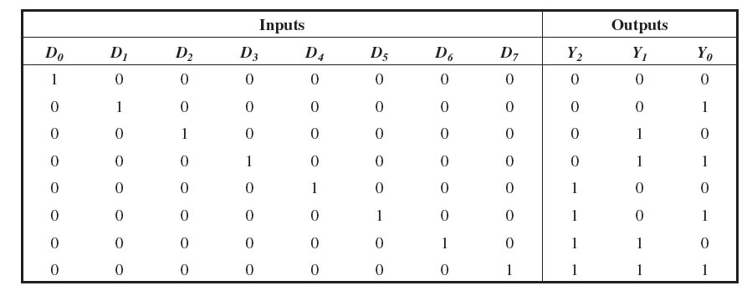
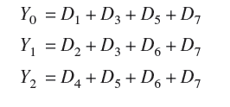
Octal to Binary Encoder

Slide 25
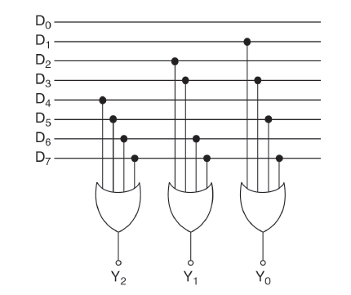

Octal to Binary Encoder

